Slide 1

WINE QUALITY PREDICTION

Slide 2
DATASET DESCRIPTION
Name. Quality Prediction
Feature Variables.
  Fixed acidity
  Volatile acidity
  Citric acid
  Residual sugar
  Chlorides
  Free Sulfur Dioxide
  Total Sulfur Dioxide
  Density
  pH
  Sulphates
  Alcohol
Target Variable. Quality
Dataset type. Multivariate
Number of Datapoints. 1599
Missing Values. N/A

Slide 3
OBJECTIVE
The objective is to predict the wine quality using machine learning through Python programming language.

Slide 4
DATA ANALYSIS

Slide 5
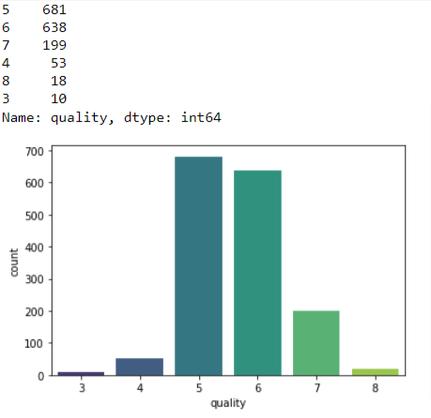
DATASET CHARACTERISTICS
The dataset has 1599 rows and 12 columns.
There are no null values.
The target label is “quality”.
The dataset is imbalanced and centered around rating of 5 and 6. This needs to be rectified.

Slide 6
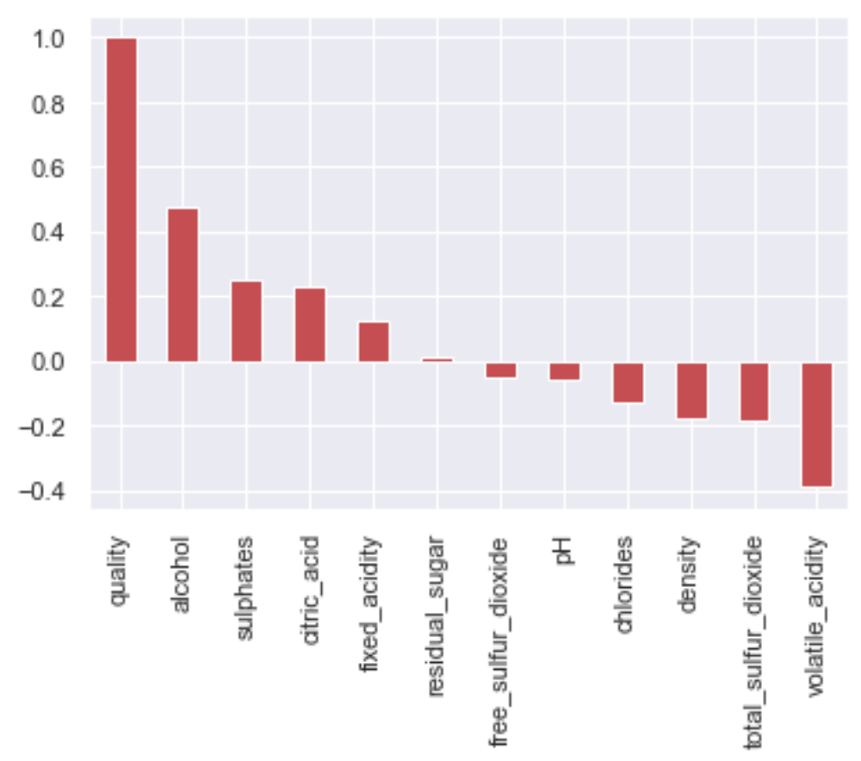
DATASET CHARACTERISTICS
Correlations. External corr with “quality “ is as shown below.
quality 1.000000
alcohol 0.476166
sulphates 0.251397
citric_acid 0.226373
fixed_acidity 0.124052
residual_sugar 0.013732
free_sulfur_dioxide - 0.050656
Ph - 0.057731
chlorides - 0.128907
density - 0.174919
total_sulfur_dioxide - 0.185100
volatile_acidity - 0.390558
Name: quality, dtype: float64

Slide 7
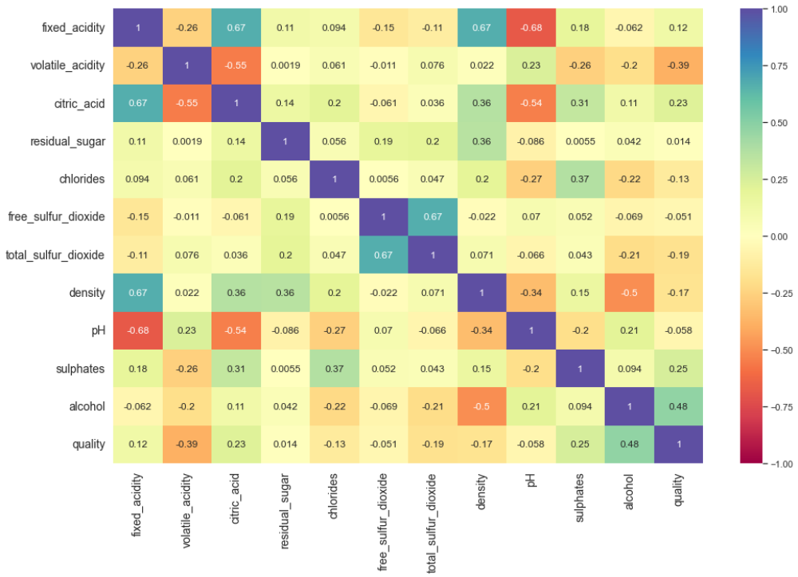
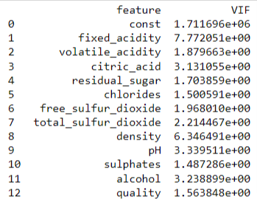
DATASET CHARACTERISTICS
Fixed_acidity & citric_acid,
fixed_acidity & density and
Free & total_sulfur_dioxide are
positively corr.
fixed_acidity & pH are
negatively corr.
Multicollinearity may exist.
Correlations. Internal corr is as shown below:
Multicollinearity using VIF
Fixed acidity & density have highest VIF.
Hence one of them can be dropped

Slide 8
PREPROCESSING & FEATURE SELECTION

Slide 9
PREPROCESSING
As part of data preprocessing the following actions were done:
  Dropping Columns. Free_sulfur_dioxide can be dropped keeping total_sulfur_dioxide. Also fixed_acidity has relatively strong corr with three other features and can be dropped to negate multicollinearity.
  Outlier Removal. Analysing the descriptive stats of the dataset, it was evident that outliers exist in the data especially in the residual_sugar, chlorides and total_sulfur_dioxide. The same has been removed using z score wherein if zscore >3, data point may be considered as outlier. This reduced the dataset to 1471 rows from initial 1599 rows.
  Rectification of Class Imbalance using SMOTE.
  Converting output label to binary. Quality >6 : 1 else 0
  Feature Scaling. StandardScalar has been used.
  Train-Test Split. 80-20.

Slide 10
ML ALGORITHMS

Slide 11
MODEL PERFORMANCE
The following models were used to predict the target variable:
  Logistic Regression
  Decision Tree Regressor/ Classifier
  Random Forest Classifier
  KNN

Slide 12
MODEL PERFORMANCE
Model | Accuracy Score | F1 Score |  | Cross Val Score cv=5
 |  | 0 | 1
Logistic Regression | 88.46 | 0.90 | 0.86 | 87.82
DecisionTreeClassifier | 90.38 | 0.92 | 0.88 | 88.49
RandomForestClassifier | 94.23 | 0.95 | 0.93 | 92.01
KNN | 89.42 | 0.91 | 0.88 | 88.20

Slide 13
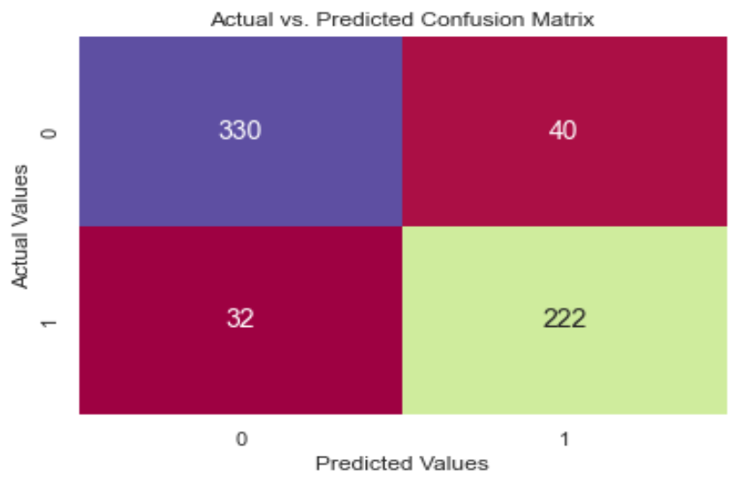


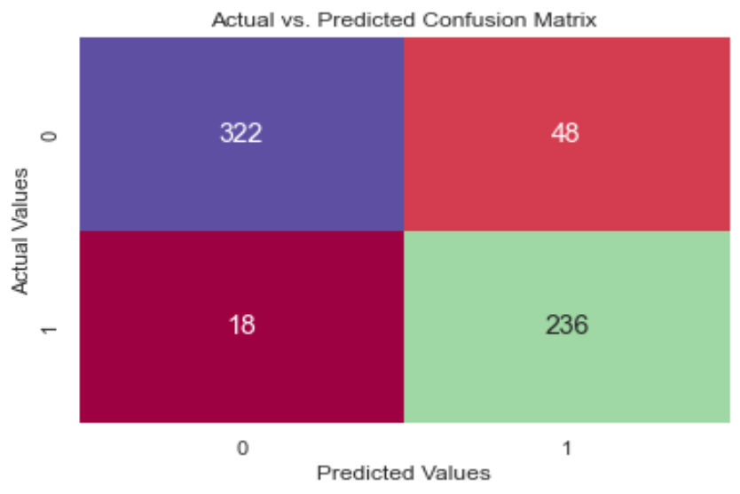
CONFUSION MATRICES
Logistic
Random Forest
Decision Tree
KNN

Slide 14
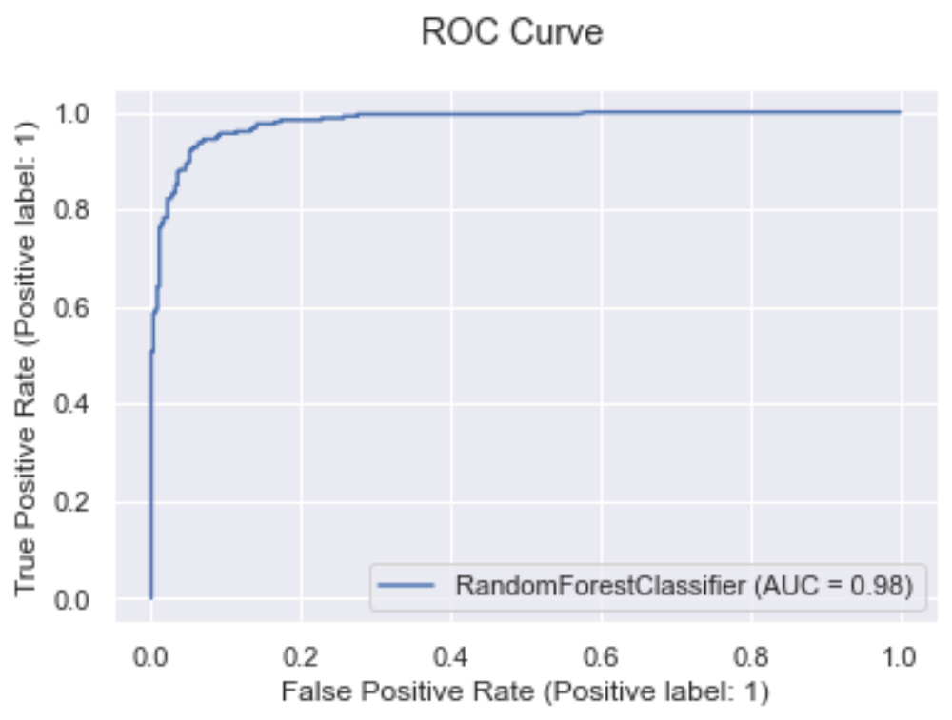
HYPERPARAMETER TUNING
Hyperparameter tuning done for the best performing model only.
GridSearchCV utilized.
Based on OOB rate, best value n_estimator identified.
Accuracy of final model ascertained. (93.58%)
ROC plotted and AUC = 98% obtained.

Slide 15
THANK YOU

